Slide 1
DEMO DAY - SLIDE (1 min)

Slide 2





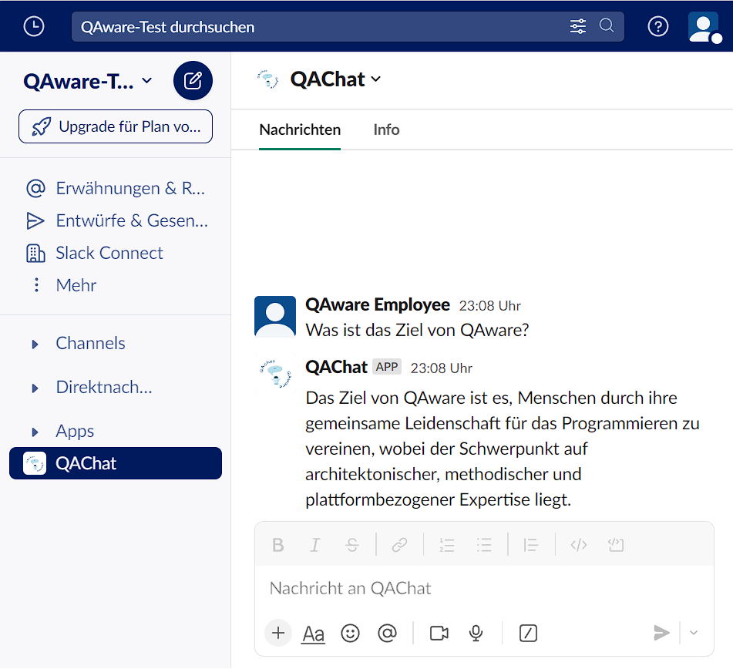


QAChat
Chatbot on Slack is based on a LLM and company-internal information.
Data retrieved from company’s Confluence, Slack and Google Drive.
Employees can ask the chatbot questions about the company.
🤖
💾
🗨️

Slide 3
DEMO DAY - PRESENTATION (10 min)

Slide 5
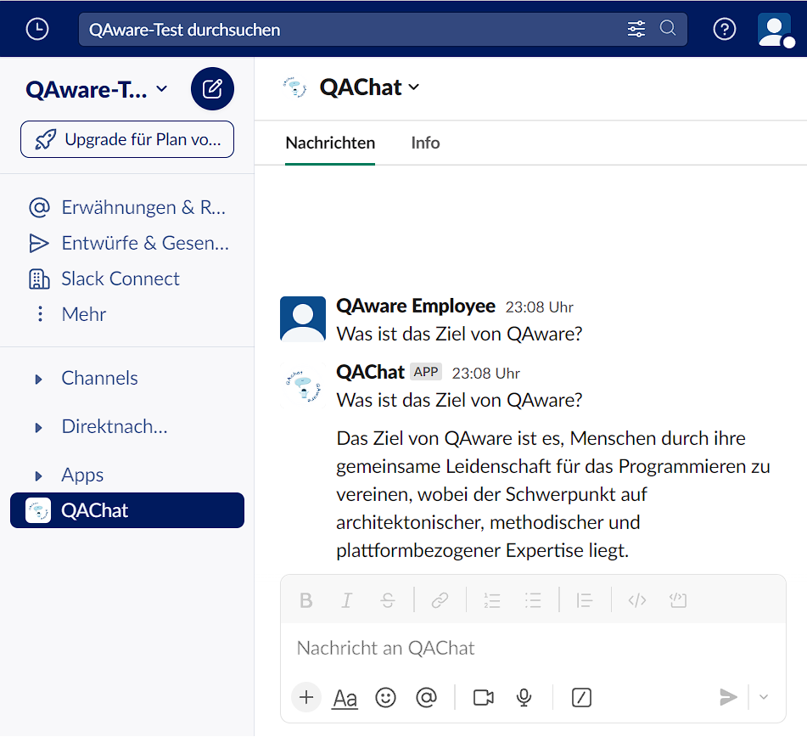
QAChat
Chatbot on slack is based on a LLM and company-internal information.
Data retrieved from company’s Confluence, Slack and Google Drive.
Employees can ask the chatbot questions about the company.
🤖
💾
🗨️

Slide 6
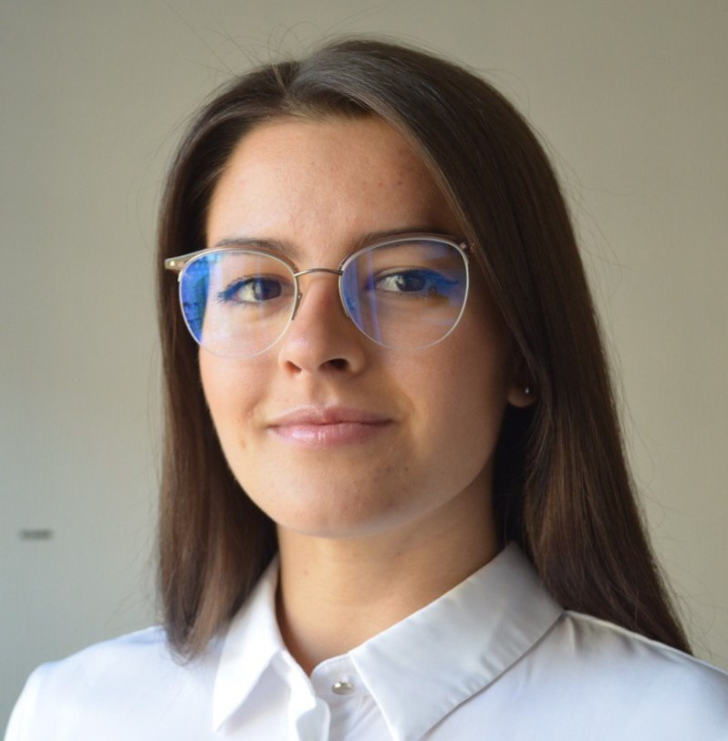

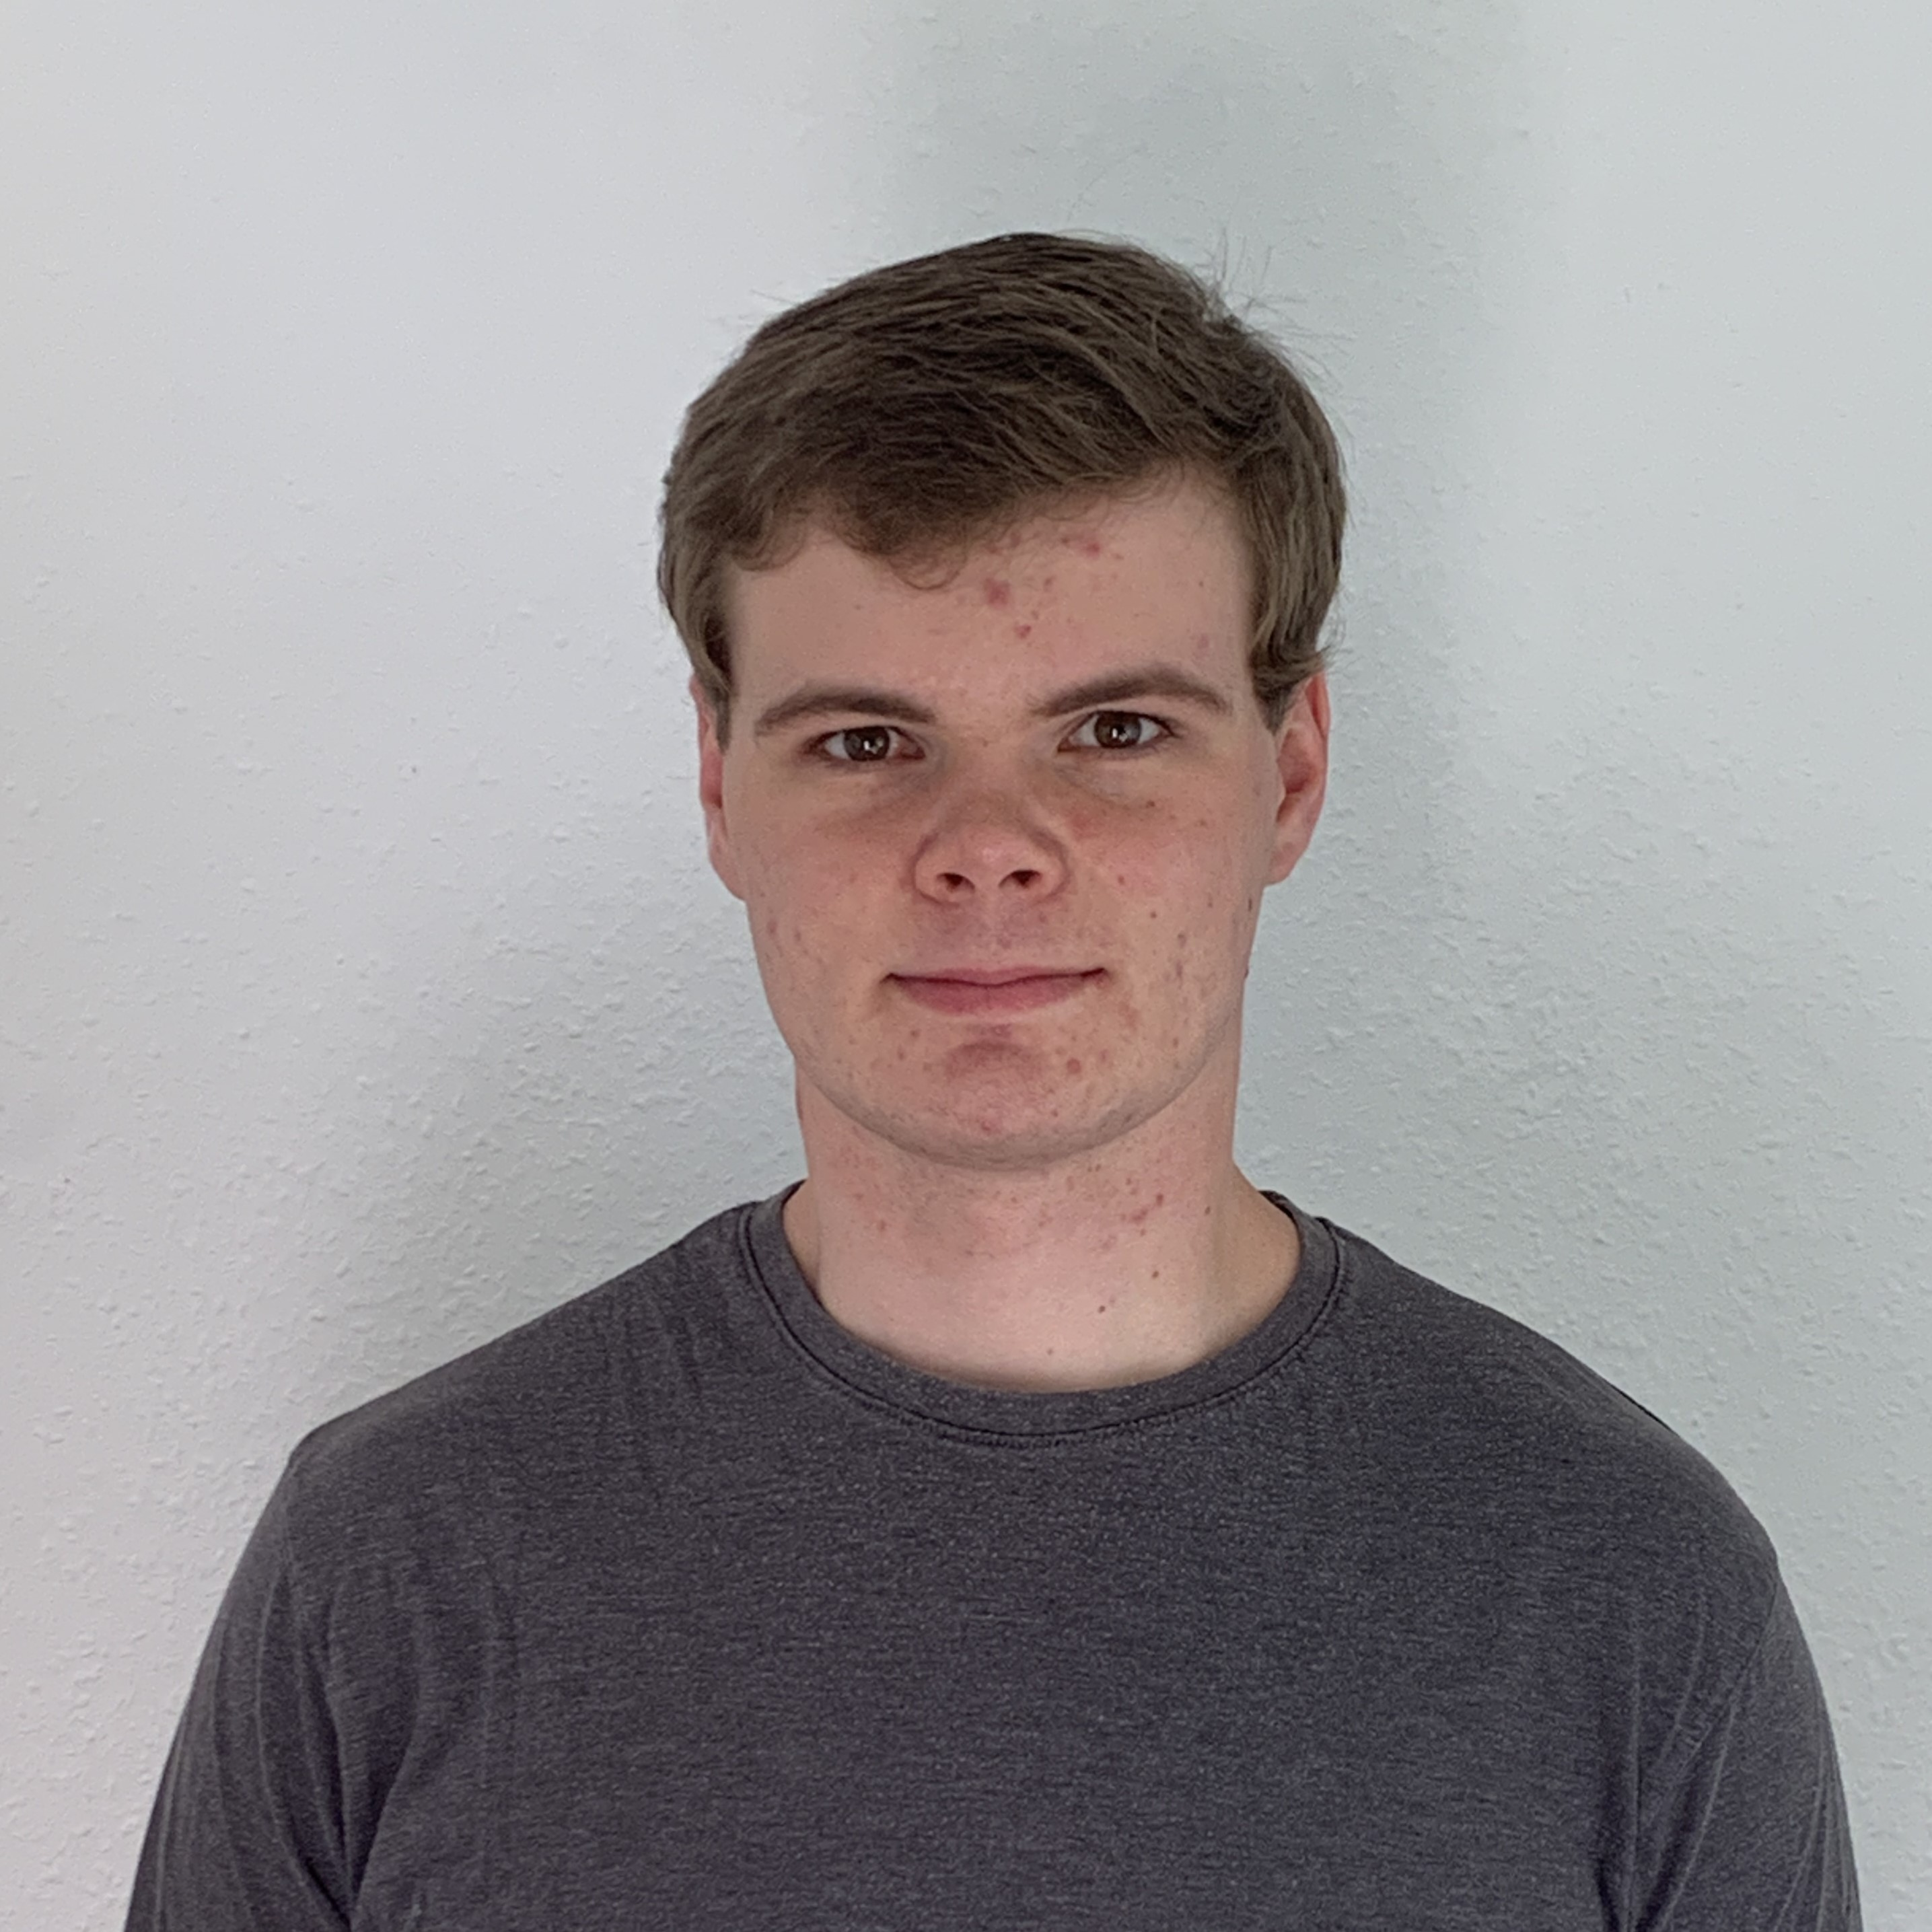
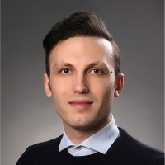
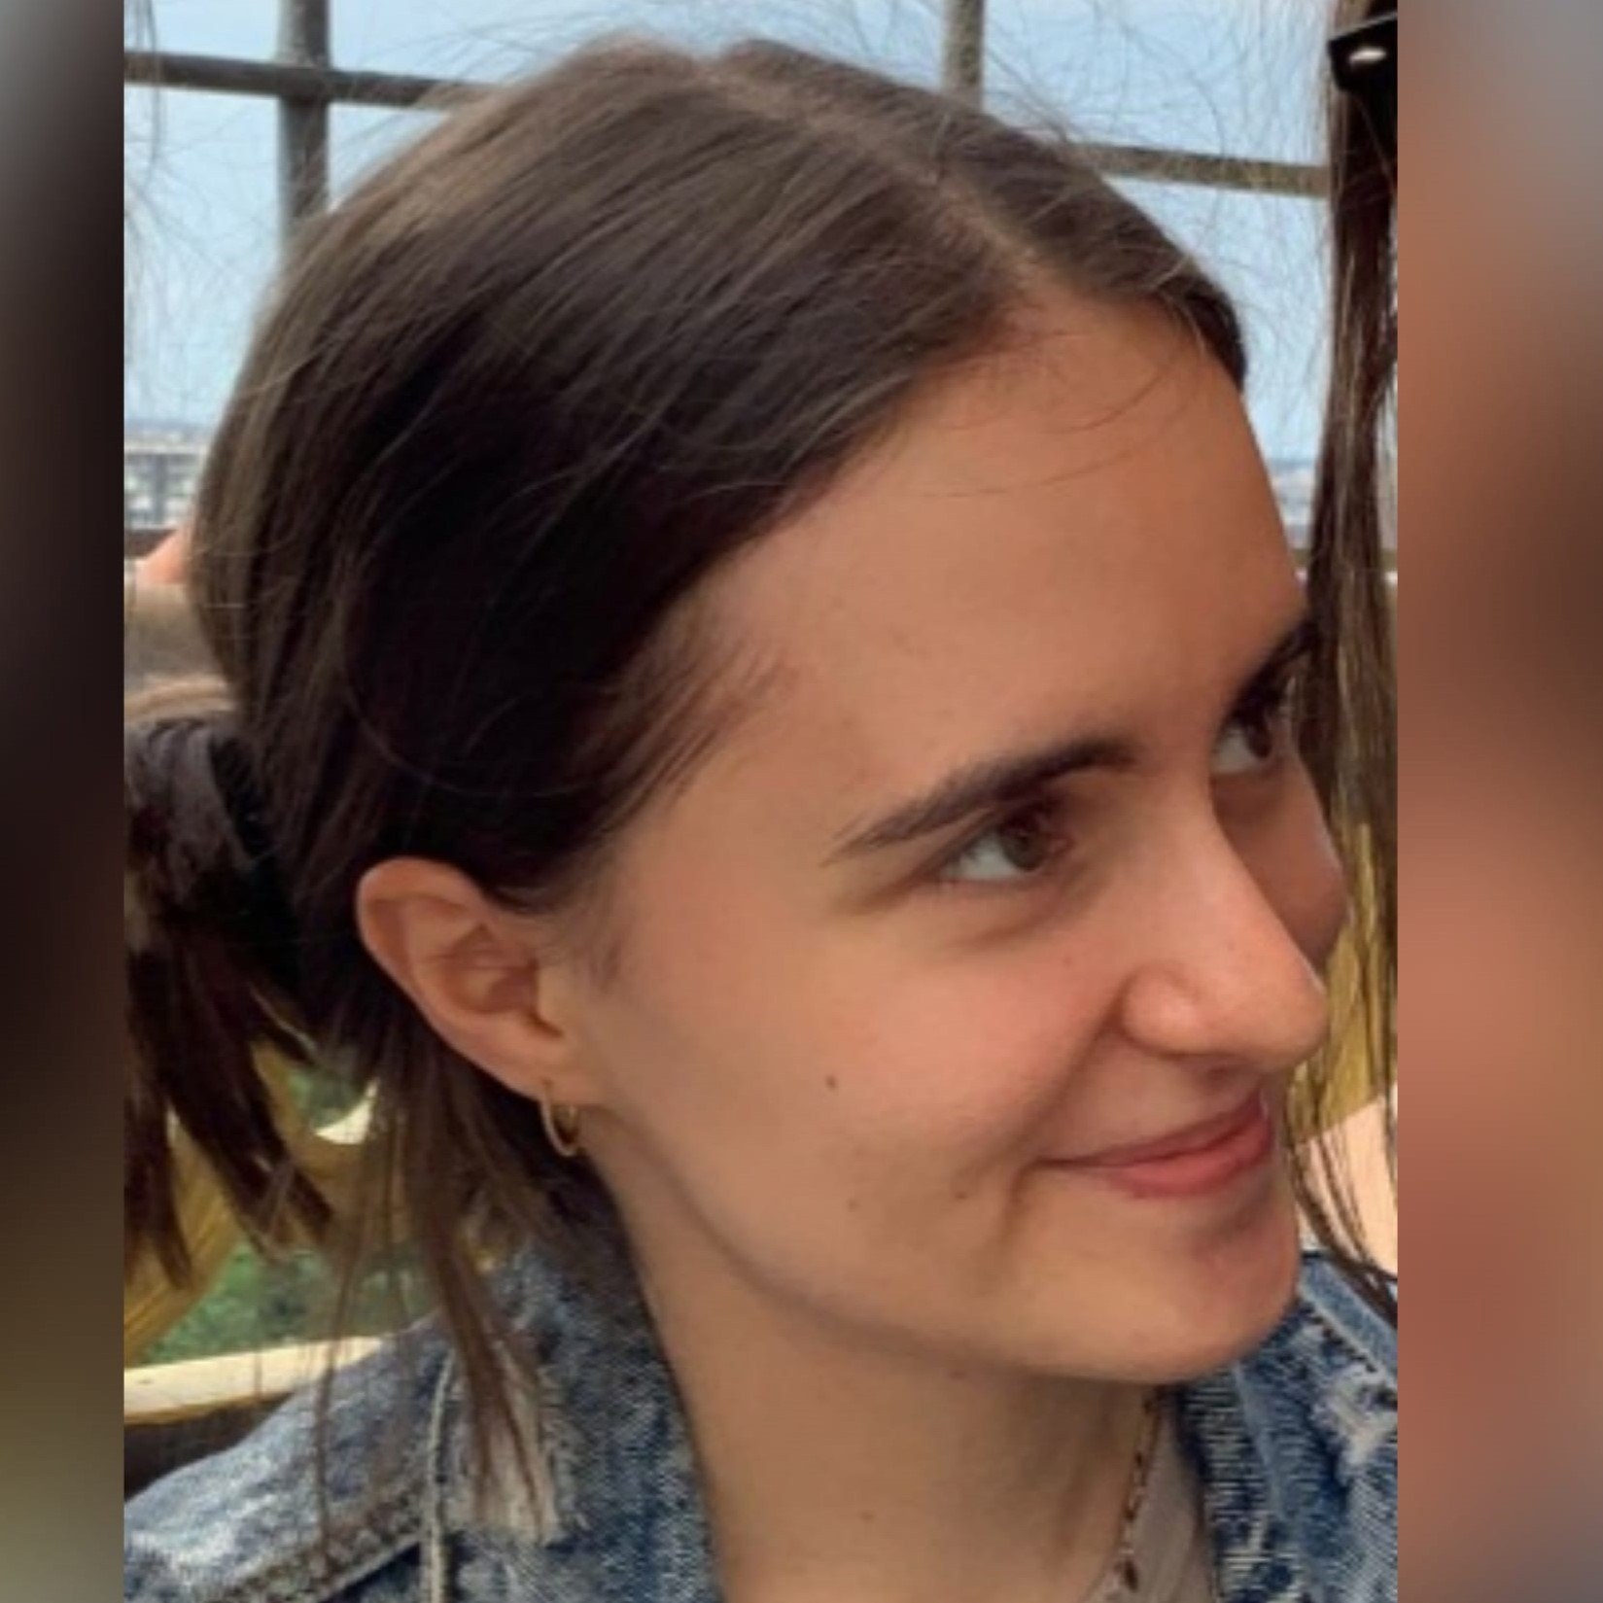




Team
📝 Scrum Master
💼 Product Owner
💻 Software Developer
📝
💼
💼
💻
Vukica
Sara
Tobias
Abdelkader
💻
💻
💻
💻
💻
Amela
Emanuel
Felix
Hafidz
Jesse

Slide 7
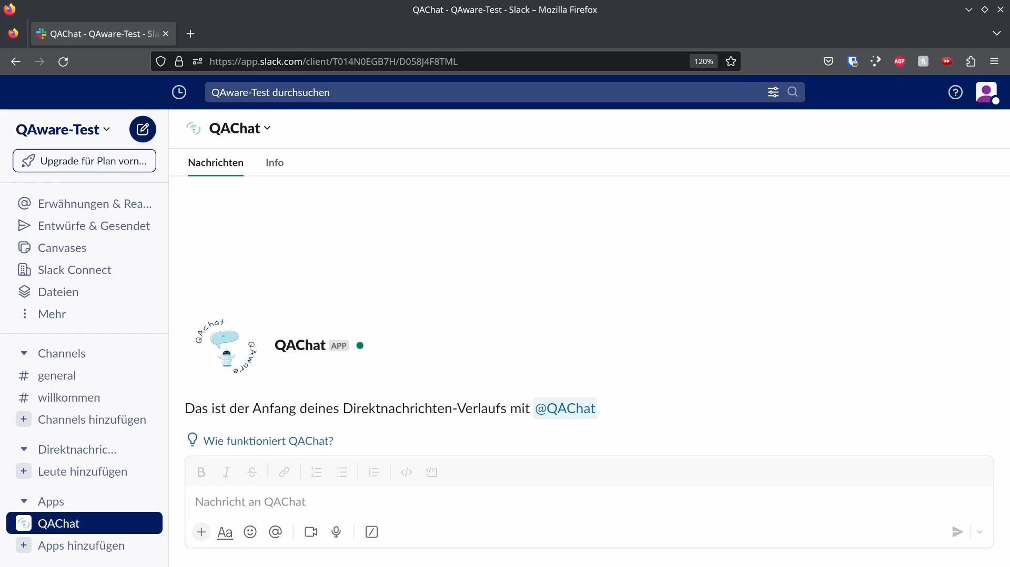
Short Animation Slack Bot

Slide 8








Goal
🤖
🔍
📜
Chatbot
Method
Policy
Notes:
1. Chatbot must …
1.1 be available as a Slack integration
1.2 be able to respond with company-specific information
1.3 support the German language
2. Data retrieval methods must be …
2.1 able to retrieve from Confluence, Slack and Google Drive
2.2 able to exclude certain data sources that are on a blacklist
2.3 automated and must run on a schedule
3. Policy
Product must only use services that comply with the company's security policy

Slide 9
Why not ChatGPT?
🌍
🛡️
💵
Open Source
Privacy
Costs
Notes:
Open source ->
more stable than GPT4 and hosting on own server
AMOS: OS stands for Open source
Privacy
Big deal in DE
Want to keep data in house
Costs
Low and consistent cost for company
Control over cost

Slide 10
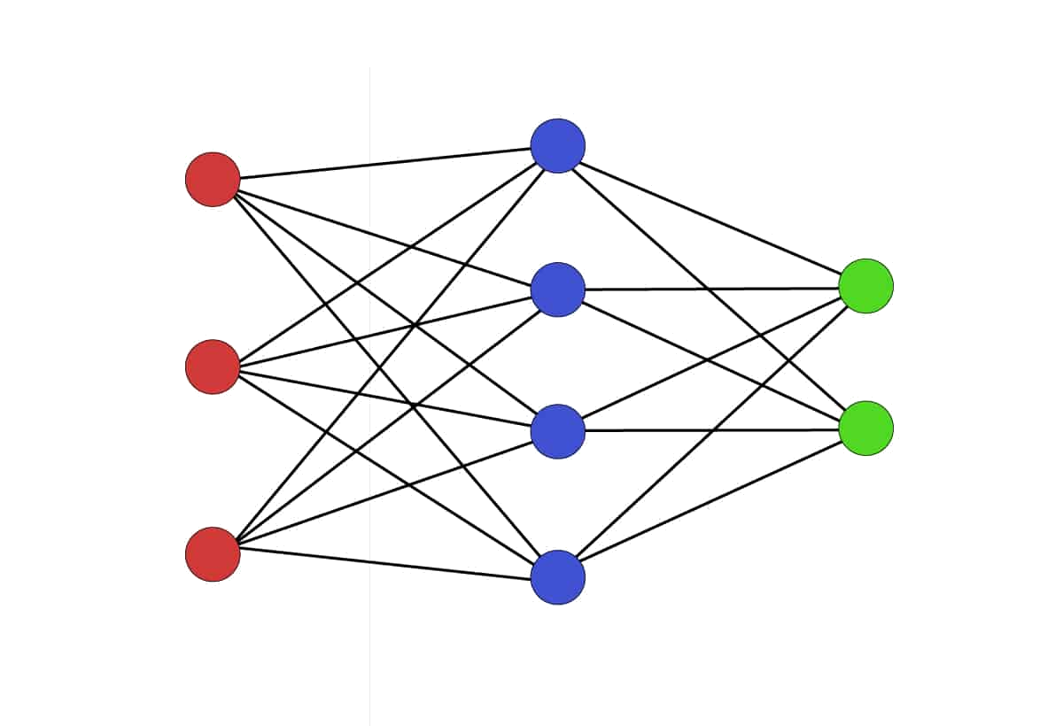
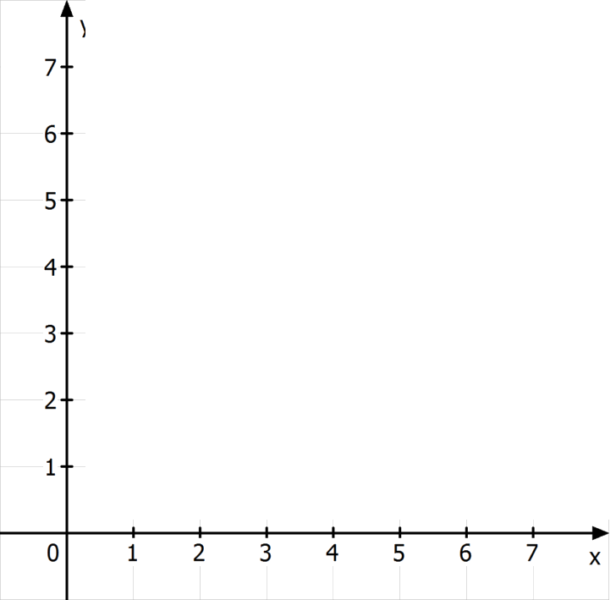
Semantic Search
Instructor-xl
Notes:
Can not use CTRL+F for data -> Solution: Semantic Search
Text embedding “Instructor-xl” converts text -> vectors
Vectors with close context will have similar angle
Yellow & green have similar direction -> similar context

Slide 11
Semantic Search
Instructor-xl
Notes:
Can not use CTRL+F for data -> Solution: Semantic Search
Text embedding “Instructor-xl” converts text -> vectors
Vectors with close context will have similar angle
Yellow & green have similar direction -> similar context

Slide 12
Semantic Search
Instructor-xl
Notes:
Can not use CTRL+F for data -> Solution: Semantic Search
Text embedding “Instructor-xl” converts text -> vectors
Vectors with close context will have similar angle
Yellow & green have similar direction -> similar context

Slide 13
Semantic Search
Instructor-xl
Notes:
Can not use CTRL+F for data -> Solution: Semantic Search
Text embedding “Instructor-xl” converts text -> vectors
Vectors with close context will have similar angle
Yellow & green have similar direction -> similar context

Slide 14
LLM / Prompt Engineering
Your primary task is ... Keep your responses short, precise, directly ...
If you are unsure, kindly state ….
TASK DESCRIPTION
CONTEXT
CURRENT INPUT
WizardLM-13B
RESPONSE
Notes:
How our LM work?
Give prompt consisting 3 parts
Task description
Context is from Semantic Search (as explained in previous slide)
Current Input (Users input from Slack)
template = ( "You are a chatbot, your primary task is to help people by answering their questions. Keep your responses short, precise, and directly related to the user's question, using the following context to guide your answer:\n" "{context_str}\n\n" "Try your best to answer based on the given context, and avoid creating new information. If the context does not provide enough details to formulate a response, or if you are unsure, kindly state that you can't provide a certain answer.\n" "\n\n" "USER: {question}" "ASSISTANT:" )

Slide 15





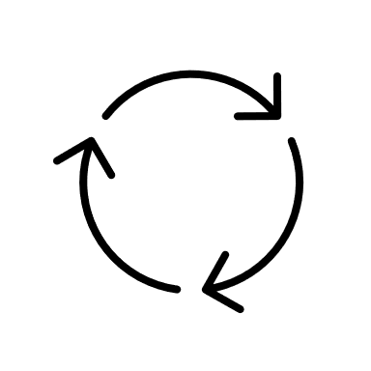




Architecture
Pages
QABot
Data Processing
Messages
Vector Database
Documents
Notes:
VM for Data Processing
VM for QABot
VM for Slack Bot
Database is stored in cloud bucket
Internally we use only English because of better semantic search / LLM
Translation is done by DeepL
But it can also run locally on PC

Slide 16

THANK YOU!

Slide 17
THANK YOU!

Slide 18


Slide 19
Architecture
Pages
QABot
Data Processing
Messages
Vector Database
Documents

Slide 20
Architecture
Pages
QABot
Data Processing
Messages
Vector Database
Documents
Demo
Notes:
Can you describe QAware's hiring process?
Wie kann ich eine USB-Umleitung für virtuelle Desktops in der Windows-VDI-Einrichtung von QAware konfigurieren?
Quels types de tests logiciels QAware effectue-t-il pendant le développement? (What types of software testing does QAware perform during development?)
Does QAWare have a canteen?
Interactive: Let audience ask question where the answer is not in DB
When bot is not running: because we ran out of money for DeepL cost

Slide 21
DEMO DAY VIDEO (3 min)

Slide 23
QAChat
Chatbot on slack is based on a LLM and company-internal information.
Data retrieved from company’s Confluence, Slack and Google Drive.
Employees can ask the chatbot questions about the company.
🤖
💾
🗨️

Slide 24
QAChat
Chatbot on Slack is based on a LLM and company-internal information.
Data retrieved from company’s Confluence, Slack and Google Drive.
Employees can ask the chatbot questions about the company.
🤖
💾
🗨️

Slide 25
Architecture
Pages
QABot
Data Processing
Messages
Vector Database
Documents

Slide 26


Requirements
1. Chatbot must …
1.1 be available as a Slack integration
1.2 be able to respond with company-specific information
1.3 support the German language
3. Policy
Product must only use services that comply with the company's security policy
2. Data retrieval methods must be …
2.1 able to retrieve from Confluence, Slack and Google Drive
2.2 able to work with German text
2.3 able to exclude certain data sources that are on a blacklist
2.4 automated and must run on a schedule

Slide 27
Demo

Slide 28
QAChat Team
Developer
Developer
Developer
Developer
Developer
Developer
Product Owner
Product Owner
Scrum Master
Abdelkader Abdelkader
Amela Pucic
Emanuel Erben
Felix Nützel
Hafidz Arifin
Jesse Palarus
Sara El Brak
Tobias Konheiser
Vukica Stojkovic
(alphabetical order)

Slide 29
QAChat Team
Scrum Master
Product Owner
Product Owner
Developer
Developer
Developer
Developer
Developer
Developer
Vukica Stojkovic
Sara El Brak
Tobias Konheiser
Abdelkader Alkadour
Amela Pucic
Emanuel Erben
Felix Nützel
Hafidz Arifin
Jesse Palarus
(alphabetical order)

Slide 30
TRASHCAN (not cannot)

Slide 32
Team
📝 Scrum Master
💼 Product Owner
💻 Software Developer

